Slide 1
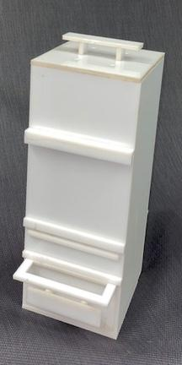
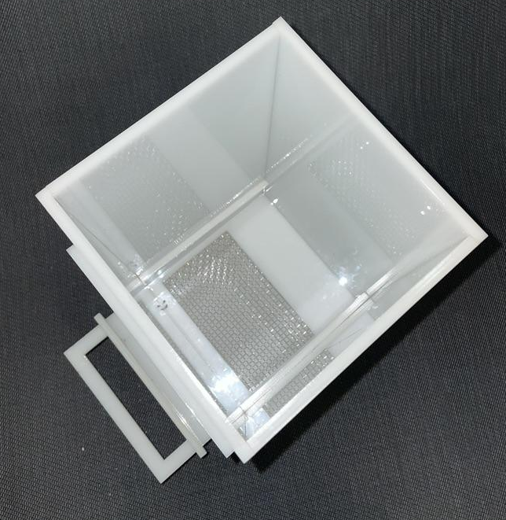
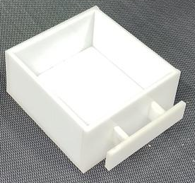
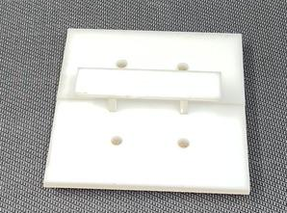
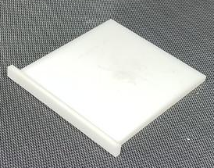

Sifty an elegant composting solution
Problem
Solution
Designing a composter that filters worm castings, prevents flies, and prevent odors
A tall, rectangular, frame that allows castings to be sifted out using the sliding filter and removed easily using the drawer
Sifter
User slides back and forth
Separates castings from food scraps and worms
Drawer
Easy extraction of castings
Portability
Lid
Odor-absorbing cork
Holes w/mesh for aeration and fly prevention
Stopper
DTC |Fall 20201|Section 5|Team 3 | Siby Suriyan | Blake Thompson | Yanni Wilcox
Stops undesired filtering
Allows casting buildup

